Slide 1
SSA Parent Information
Notes:
Welcome to the Single Subject Acceleration parent presentation.

Slide 2
What is Single Subject Acceleration (SSA)?
Single Subject Acceleration (SSA) is the practice of assigning a student to a higher-grade level than is typical, given the student’s age, for the purpose of providing access to appropriately challenging learning opportunities in either Math or English Language Arts.
Notes:
Single Subject Acceleration (SSA) is the practice of assigning a student to a higher-grade level than is typical, given the student’s age, for the purpose of providing access to appropriately challenging learning opportunities in either Math or English Language Arts.
Who is eligible to be nominated?
Any student who is enrolled in Wake County Public School system during the SSA Test Request Window is eligible for testing.

Slide 3
Who can be tested for SSA?
Kindergarten through 7th grade in math
Kindergarten through 7th grade in reading
Requests come from parents
Notes:
Who is eligible to be tested for SSA? Any Wake County Public School System student in Kindergarten through 7th grade can have their parent request testing for single subject acceleration in reading or math. Teachers may also request single subject testing for a student. The SSA testing window is the only time during the school year that a child can be tested for SSA. Single Subject Acceleration always starts the following school year.

Slide 4
SSA Process from Test Request to Results
Test Request
Testing
Results
Results are shared with parents.
Parents or teachers complete a test request form during the open Test Request Window.
Students test in a secure setting during the open Testing Window.
Schools prepare for testing.
Schools submit answer documents to Advanced Learning Services.
Schools review results. Results will be used to plan instruction for the following school year.
Notes:
This graphic shows the SSA process. First parents need to complete a test request form and return it to their schools before the Test Request deadline. During the schools testing window, the SSA tests will be administered to students. Results will be shared with parents once score have been returned. SSA services will begin the following school year.

Slide 5
Single Subject Acceleration
SSA Parent Test Request Windows
Leadership Academies: Feb. 24-28 | Modified Calendar: Feb. 24-28
Year Round Track 1: Feb. 24-28 | Year Round Tracks 2, 3, 4: March 23-27
Barwell ES, Fox Rd ES, & Walnut Creek ES: March 16-20 | Traditional Calendar: March 23-27
Testing Windows
Leadership Academies: April 6-21 | Modified Calendar: April 1-15
Year Round Tracks 1-3: April 13-23 | Year Round Track 4: April 28-May 8
Barwell ES, Fox ES & Walnut Creek ES: May 11-27 | Traditional Calendar: April 20-30
Notes:
It is important to make sure that all test requests are given to the school’s SSA contact before the test request window closes. Test requests will not be accepted after the window has closed as materials have to be ordered early to assure that all deadlines are met. If you are unsure of your school calendar, reach out to your schools SSA contact for more information.

Slide 6
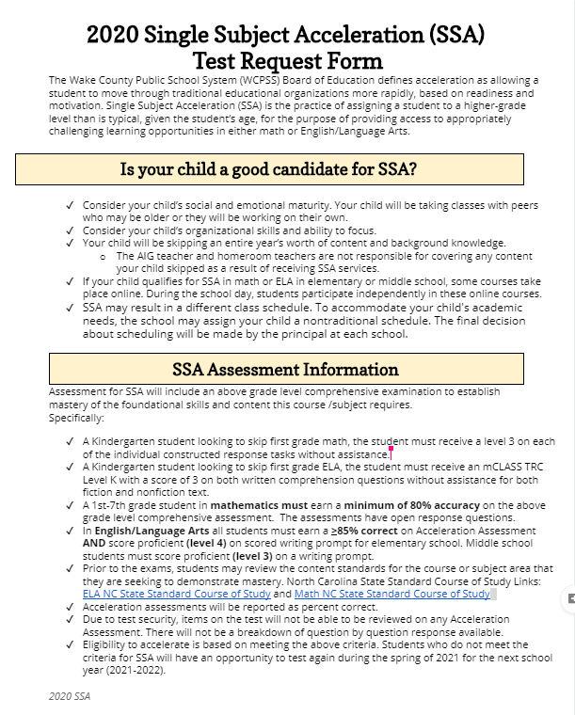
Test Request Form
Notes:
The test request form is available from your schools. Please be sure to read the two sections titled: “Is your child a good candidate for SSA?” And “SSA Assessment Information” before returning the signed paperwork into your school's SSA contact.

Slide 7
SSA Testing
Students test an entire grade level above their current grade level.
For example:
a 3rd grade student takes a 4th grade assessment,
a 6th grade student takes a 7th grade assessment.
Notes:
When a student takes the Single Subject Acceleration testing, note that the student will be taking the grade level test that the student will be skipping.
For example:
a 3rd grade student will be taking a 4th grade assessment,
a 6th grade student will be taking a 7th grade assessment.

Slide 8
SSA Math Assessments
Student Current Grade Level | Grade/ Course Requesting to Skip | Assessment used to Qualify | Assessment Format | Qualifying Criteria
Kindergarten | 1st Grade Math | 1st Grade NCDPI Summative Math Assessment | Individual constructed response tasks, created by NCDPI | Student receives a 3 (proficient) on each assessment task (will be reviewed by centralized team)
1st Grade | 2nd Grade Math | Grade 2 Assessment | Multiple choice and open-ended assessment items with both calculator active and inactive sections. Approximately 25% of the assessment is open-ended math questions. | >80% correct on Acceleration Assessment
2nd Grade | 3rd Grade Math | Grade 3 Assessment
3rd Grade | 4th Grade Math | Grade 4 Assessment
4th Grade | 5th Grade Math | Grade 5 Assessment
5th Grade | 6 PLUS Math | 6 PLUS Assessment
6th Grade and 7th Grade | 7 PLUS Math | 7 PLUS Assessment
Notes:
This slide outlines the assessment format and qualifying criteria for students looking to skip math content.
Students who are currently in Kindergarten, will need to be proficient or score a level 3 on each performance task on the end of year 1st grade assessment.
In order for students who are currently in grades 1- 7 to qualify for SSA in math, they will need to score an 80% or higher on the acceleration assessment.
There are multiple choice and open-ended assessment items on the first grade through 7th grade math assessment.

Slide 9
SSA ELA Assessments
Student Current Grade Level | Grade/ Course Requesting to Skip | Assessment used to Qualify | Assessment Format | Qualifying Criteria
Kindergarten | 1st Grade ELA | mCLASS | mCLASS TRC level, including two written comprehension questions | mCLASS TRC Level K with a score of 3 on the two written comprehension questions for both a fiction and a nonfiction text.
1st Grade | 2nd Grade ELA | Grade 2 Assessment | All assessments are similar to the format used for End of Grade Tests. They are multiple choice. | .
2nd Grade | 3rd Grade ELA | Grade 3 Assessment
3rd Grade | 4th Grade ELA | Grade 4 Assessment
4th Grade | 5th Grade ELA | Grade 5 Assessment
5th Grade | 6th Grade ELA | Grade 6 Assessment
6th Grade | 7th Grade ELA | Grade 7 Assessment
7th Grade | 8th Grade ELA | Grade 8 Assessment
In English/Language Arts all students must earn >85% correct on Acceleration Assessment AND score proficient (level 4) on scored writing prompt for elementary school. Middle school students must score proficient (level 3) on a writing prompt.
Notes:
This slide outlines the assessment format and qualifying criteria for students looking to skip ELA content.
Kindergarten students looking to skip 1st grade ELA during the 2020- 2021 school year, will be administered an mCLASS assessment. In order to qualify for skipping content, a student must have a Text Reading Comprehension (TRC) at a level K or higher in BOTH Fiction and Non-Fiction. The student must also receive a “3” on the written comprehension questions for both texts. This writing sample is unassisted.
To qualify for SSA, students in grades 1-7 will need to demonstrate that they have mastered the writing and reading standards for the course to be skipped.

Slide 10
SSA Results
SSA contact will send home a results letter
Scores will be reported in percentages.
SSA services will not take place until the next school year
Notes:
The SSA contact at your school will send home a results letter
Scores will be reported in percentages.
SSA services will not take place until the next school year

Slide 11
SSA Data
Qualifies for SSA
Notes:
SSA testing is rigorous. One in five students tested, qualify for math Single Subject Acceleration. The number of students to qualify for Single Subject Acceleration in ELA is less.

Slide 12
Is my child a good candidate for SSA?
Consider your child’s social and emotional maturity, organizational skills, and ability to focus.
Students will be skipping an entire year’s worth of content and background knowledge.
If your child qualifies for SSA in math or ELA in elementary or middle school, understand that some courses take place online.
SSA may result in a different schedule.
Notes:
Consider your child’s social and emotional maturity, organizational skills, and ability to focus as students An SSA student will be taking classes with peers who may be older or they will be working on their own.
Your child will be skipping an entire year’s worth of content and background knowledge. The AIG teacher and homeroom teachers are not responsible for covering any content your child skipped as a result of receiving SSA services.
If your child qualifies for SSA in math or ELA in elementary or middle school, some courses take place online. During the school day, students participate in these courses. Students work independently during their online lessons.
SSA may result in a different class schedule. To accommodate your child's academic needs, the school may assign your child a nontraditional schedule. The final decision about scheduling will be made by the principal at each school.

Slide 13
Parent Reflection
Have I had conversations about the need for skipping a whole grade level’s content with my child’s teacher?
How is my child currently performing in the subject area where I might request acceleration?
Have I considered what SSA might look like and mean for my child, in future grades?
Do all conversations and data indicate that my child has a need for skipping a year’s worth of content, in order to receive access to rigorous curriculum or challenging curriculum?
Notes:
Determining if your child is a good candidate for SSA can be a challenging decision. Take time to reflect about these four questions.
Have I had conversations about the need for skipping a whole grade level’s content with my child’s teacher?
How is my child currently performing the subject area where I might request acceleration?
Have I considered what SSA might look like and mean for my child, in future grades?
Do all conversations and data indicate that my child has a need for skipping a year’s worth of content, in order to receive access to rigorous curriculum or challenging curriculum?

Slide 14
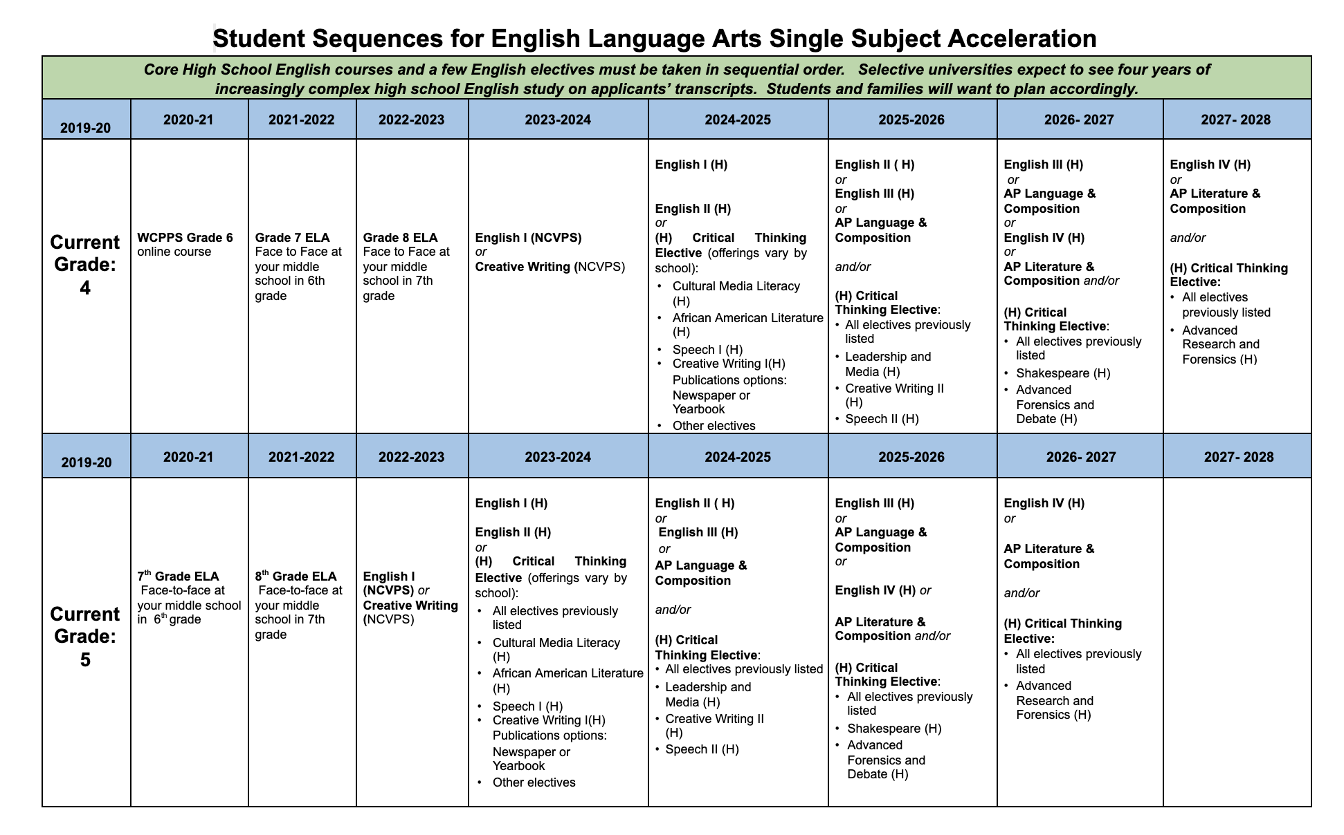
Looking Down the Road...ELA
Notes:
Click to first red circle: Students who are in Grade 4 and qualify for SSA will enroll in a WCPSS online Grade 6 course at their school during Grade 5. These students will then take the Grade 7 and 8 ELA courses face to face in their middle school during their 6th and 7th grade. During 8th grade, students will enroll in EITHER English I (NCVPS) or Creative Writing (NCVPS) for a year-long course. Students must choose one of these two courses only.
Click to second red circle: Students who are currently in grade 5 who qualify for SSA, will take the Grade 7 and 8 ELA courses face to face in their middle school during their 6th and 7th grade. During 8th grade, students will enroll in EITHER English I (NCVPS) or Creative Writing (NCVPS) for a year-long course. Students must choose one of these two courses only.

Slide 15
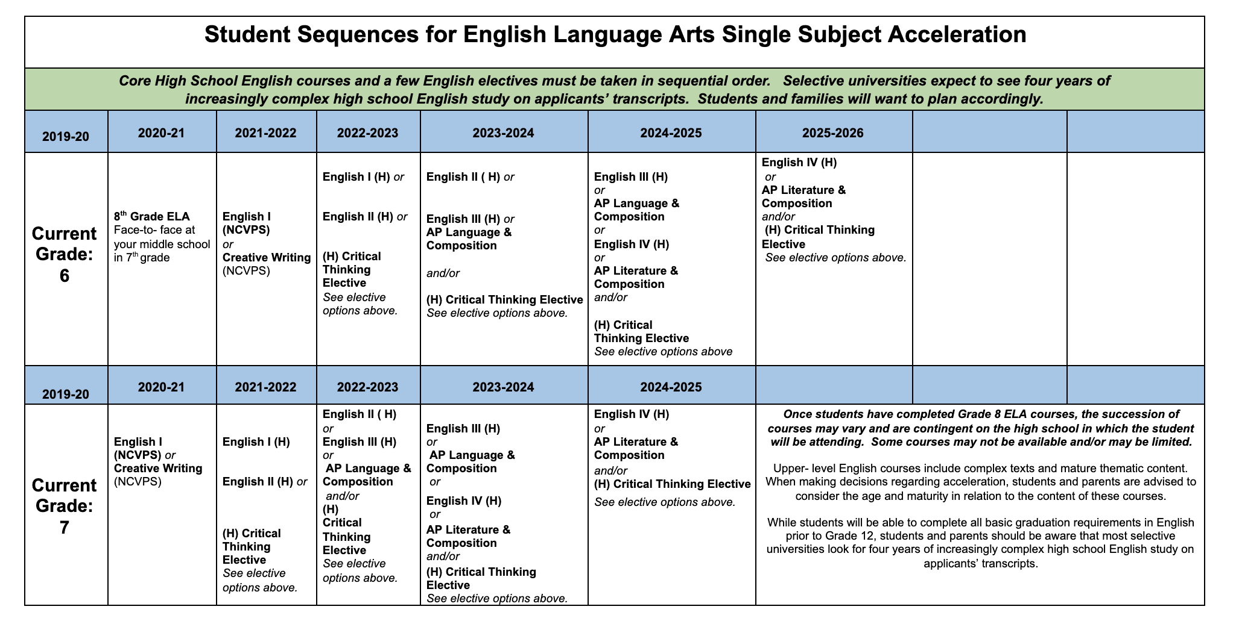
Looking Down the Road...ELA
Notes:
Click to first red circle: Current 6th graders who qualify for SSA will take the Grade 8 course face to face in their middle school during 7th grade. During 7th grade, students will enroll in EITHER English I (NCVPS) or Creative Writing (NCVPS) for a year-long course. Students must choose one of these two courses only.
Click to second red circle: Current 7th graders who qualify for SSA will enroll in EITHER English I (NCVPS) or Creative Writing (NCVPS) for a year-long course. Students must choose one of these two courses only.
Click to blue circle: Once students have completed Grade 8 ELA courses, the succession of courses may vary and are contingent on the high school in which the student will be attending. Some courses may not be available and/or may be limited.
Upper- level English courses include complex texts and mature thematic content. When making decisions regarding acceleration, students and parents are advised to consider the age and maturity in relation to the content of these courses.
While students will be able to complete all basic graduation requirements in English prior to Grade 12, students and parents should be aware that most selective universities look for four years of increasingly complex high school English study on applicants’ transcripts.

Slide 16
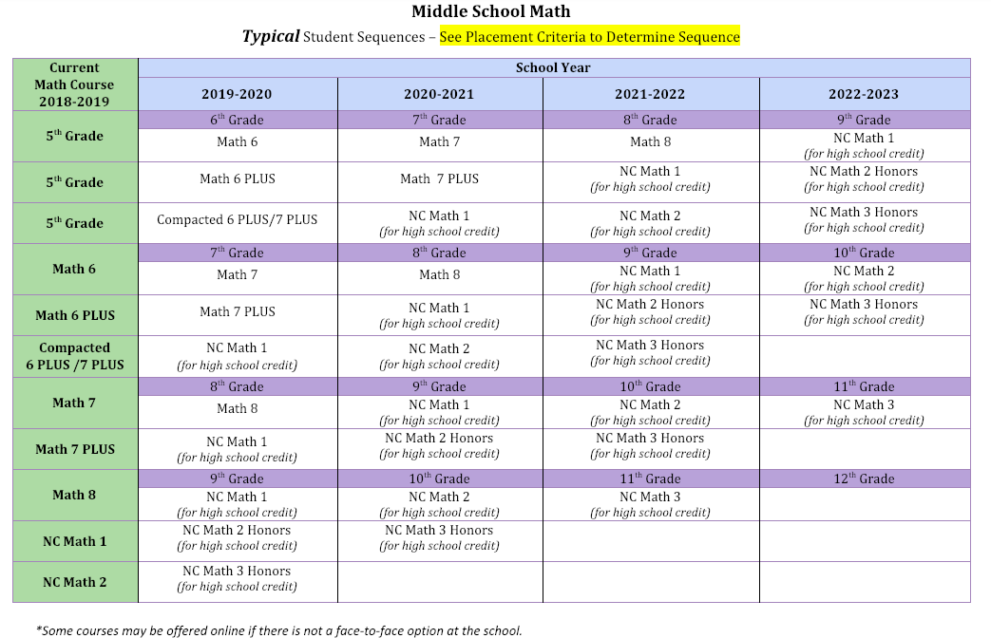
Looking Down the Road...Math
Notes:
This chart shows the math trajectory options available to all students without having to complete the SSA process. In order to read this chart, find your current students placement and look at his or her options.

Slide 17
Looking Down the Road...Math
Important to Know…
The content is the same no matter which course you take.
The thing that changes is the amount of content included in one school year.
With Acceleration...
Notes:
This document shows with more detail middle school math progression for all capable students. Students will have the opportunity to take these classes without having to complete the SSA process.
To qualify for Plus courses, students must meet criteria established in the guidelines or thru principal approval.
Elementary principals will make an initial recommendation in any waivers, but the middle school principal will make the final placement.
Students may move from math 6 to math 7 plus by meeting criteria established in the guidelines or thru principal approval.

Slide 18
Looking Down the Road...Math
What is it?
Covers 3 years of content in one school year. It covers 6th, 7th, and 8th grade content
Accelerative option that does not involve skipping content
Requires a student who is ready to both pick up content quickly and at times independently
How will schools deliver this?
Traditional Classroom Model
Blended Instruction (Math 6 Plus class with online learning modules for Math 7 Plus content)
Notes:
Compacted 6 Plus/7Plus will still be an option for students. Compacted Math 6 Plus/7 Plus is NOT part of SSA. It remains an option for all who meet the criteria. For more information, contact your schools 5th grade teachers and counselors.

Slide 19
Summary
Single Subject Acceleration is for Wake County Public Schools students in Kindergarten through 7 grade.
Complete the test request form by the end of the test request window assigned to your child’s school.
Students can test in one subject area only (reading or math)
Notes:
To recap
Single Subject Acceleration is for Wake County Public Schools students in Kindergarten through 7 grade.
Please make sure to complete the test request form by the end of the test request window assigned to your child’s school.
Students can test in one subject area only (reading or math)

Slide 20
Summary
The math assessment has multiple choice and open ended question types
The ELA assessment has a written portion well as reading.
Consider how Single Subject Acceleration will affect your child’s educational career for high school and college.
Notes:
The math assessment has multiple choice and open ended question types
The ELA assessment has a written portion well as reading.
Consider how Single Subject Acceleration will affect your child’s educational career for high school and college.

Slide 21
Notes:
The beautiful thing about learning is that no one can take it away from you. Thank you for your attention. If you questions about this presentation, please reach to the Single Subject Acceleration contact at your school. Have a great day.

